Slide 1
Checkmate Project Update
Esai Jimenez, Autumn Hale, Trentin Barnhart

Slide 2
Current Progress
We are currently about 90% complete with the project.
There are no significant changes to our initial project design but there have been many minor tweaks
Mostly, but not entirely, in UI and text displays
Most features are entirely completed
Some features are still under development

Slide 3
Some Slight Visual Clarifications
Two things were added that were not specified in the design
A Nav Bar was added as per the requirements (this was specified in the design)
Small tweaks were made to positioning and what links were provided
A color palette was selected for the entirety of the site
Initially there was little to no consideration for this

Slide 4
Primary Game Modes Progress
The core of the project is entirely functional
This includes Classical mode and Bullet mode
Both game modes pull random puzzles from the database, track the score, and increase difficulty as per the requirements
Bullet mode’s timer also works correctly, currently set to 1 minute with 20 seconds added for each solved puzzle

Slide 5
Classic and Bullet Mode Changes
Various small UI tweaks have been made to the Classic and Bullet mode UI’s as well as the menu to enter these game modes
A start button was added to both game modes
The title of both modes have been moved

Slide 6
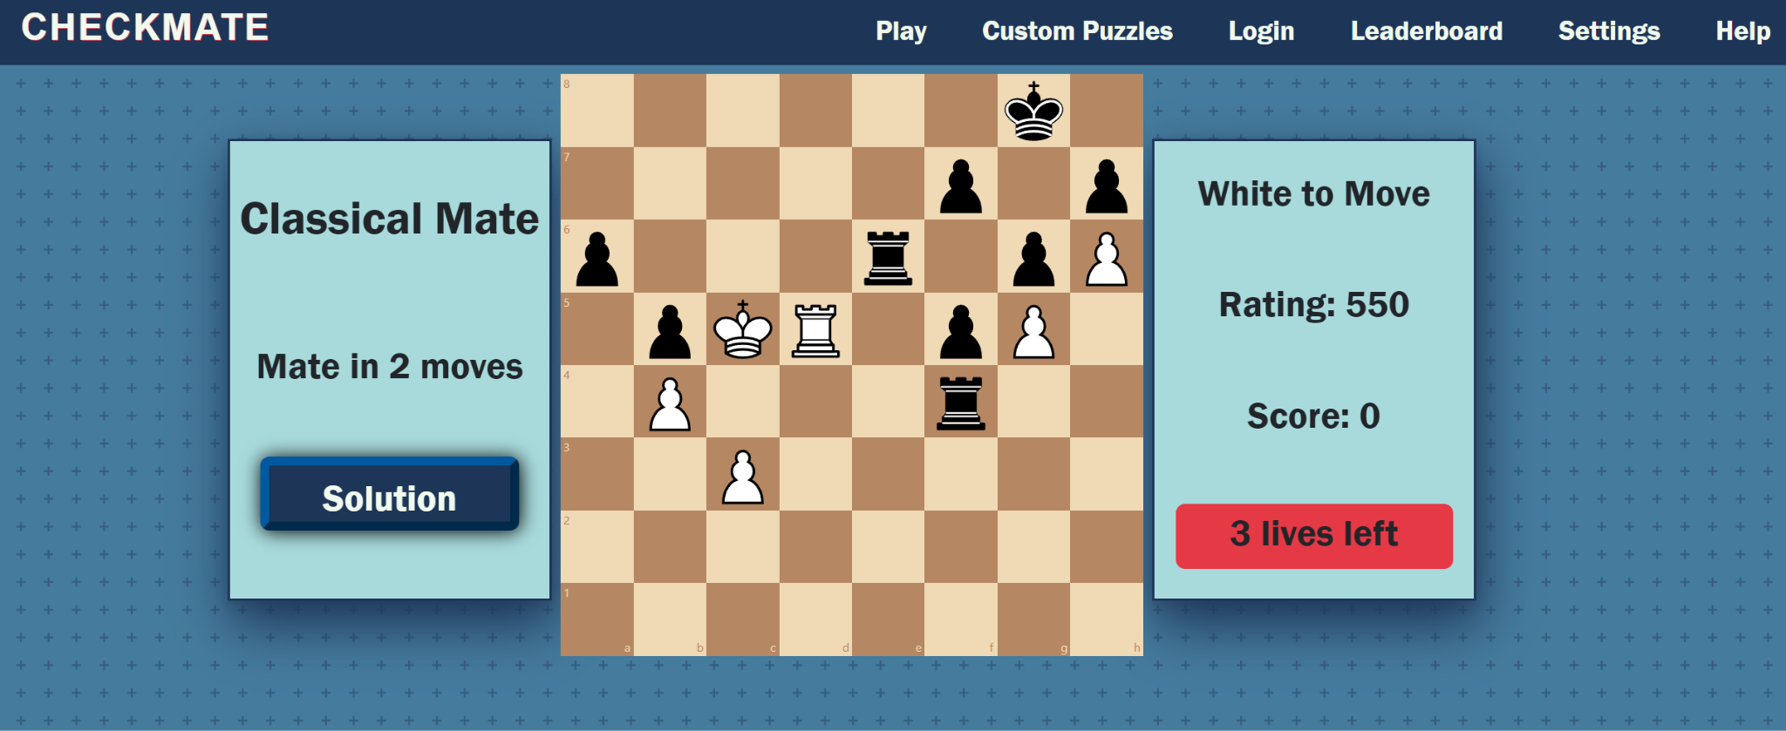
Classical Mate

Slide 7
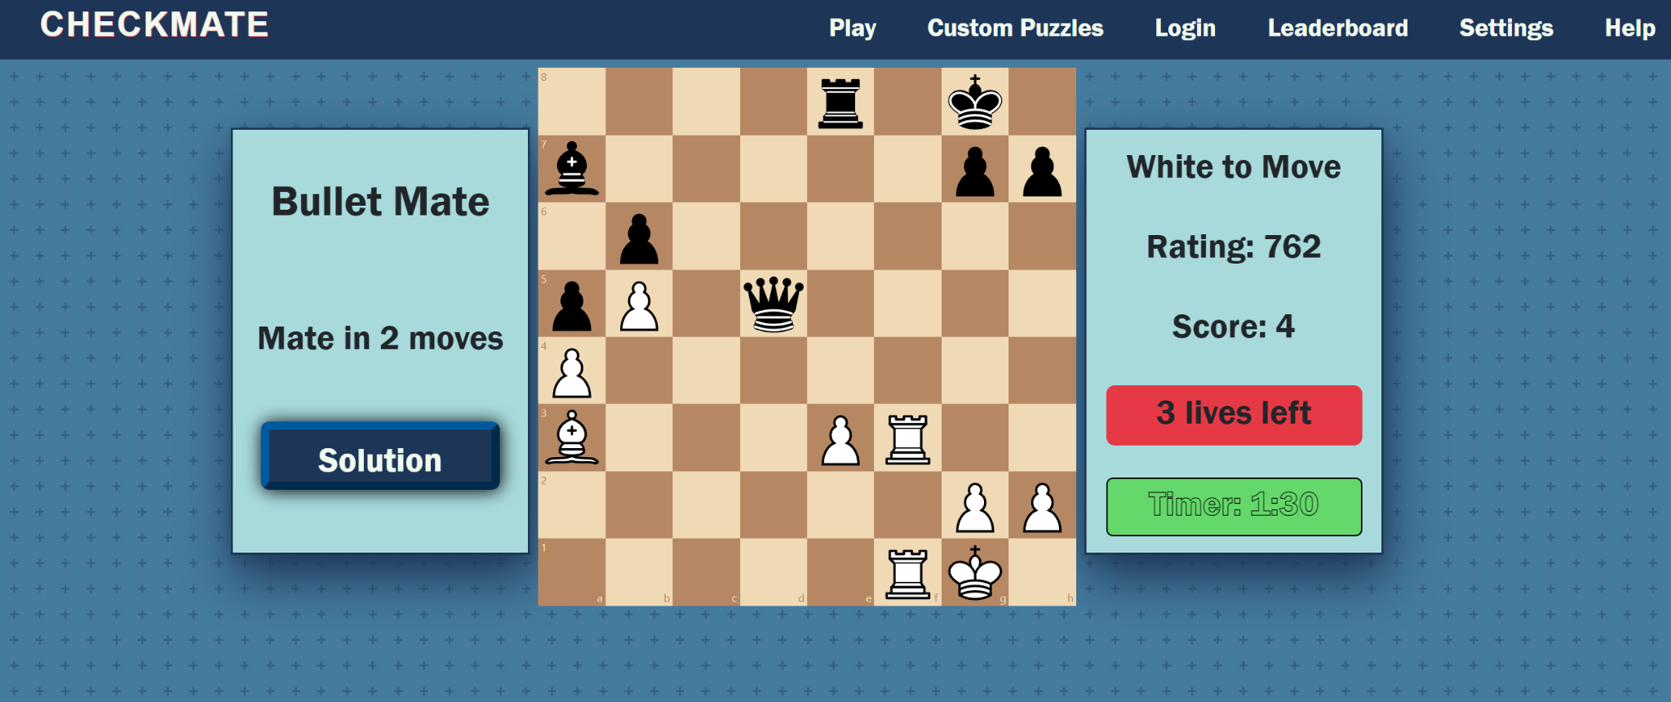
Bullet Mate

Slide 8
Custom Puzzle Progress
The Custom Puzzles Create mode is also working
It is currently able to create and submit puzzles to the database
The Puzzle List and Play mode still require some styling
Custom puzzles do not currently require a user to be logged in yet
Custom puzzles also do not currently have a rating system integrated

Slide 9
Custom Puzzles Creation Changes
Two small images have been added under the “Create” and “Play” button
Create button does not redirect to the Login UI if not logged in
Pieces are placed above and below the board rather than off to the side
A tutorial button has been added that explains puzzle creation and shows an example
Confirm Position, Confirm Solution, Reset Position, and a Back button are located on the left side
A popup alerts the user if they attempt submitting an invalid board state

Slide 10
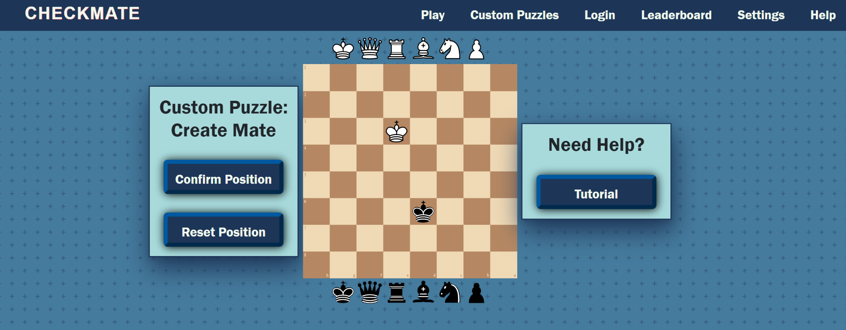
Create Mate

Slide 11
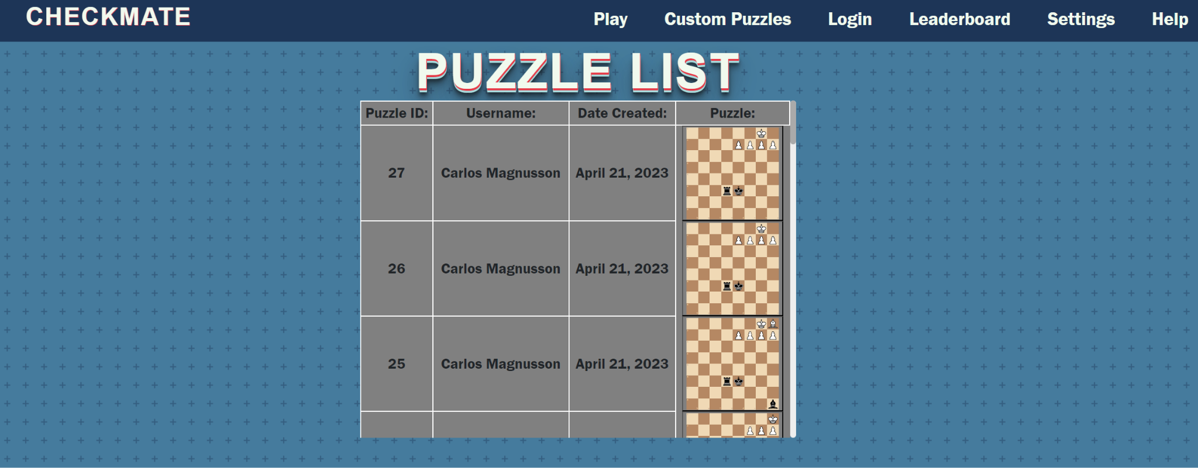
Puzzle List

Slide 12
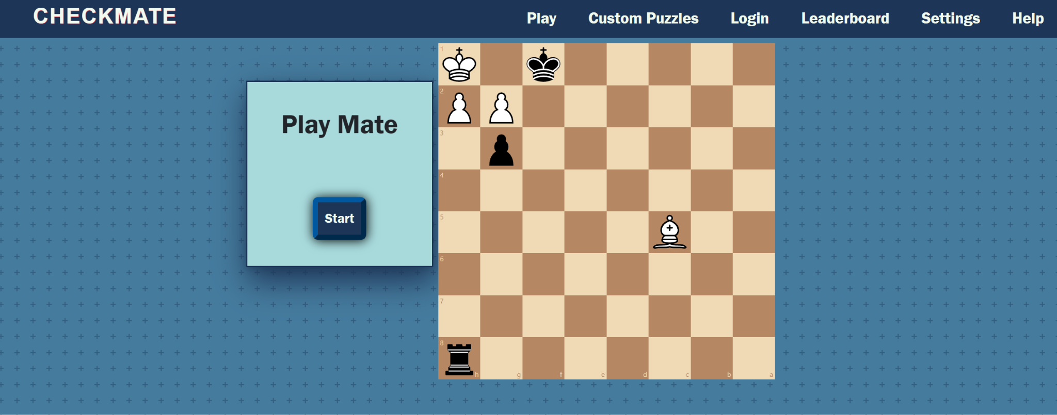
Play Mate

Slide 13
Leaderboard and Login Progress
The leaderboards are able to read and display data
Leaderboards can pull scores from database, but no username is stored yet
Currently filled with some dummy data for testing
Login requirements still have some work

Slide 14
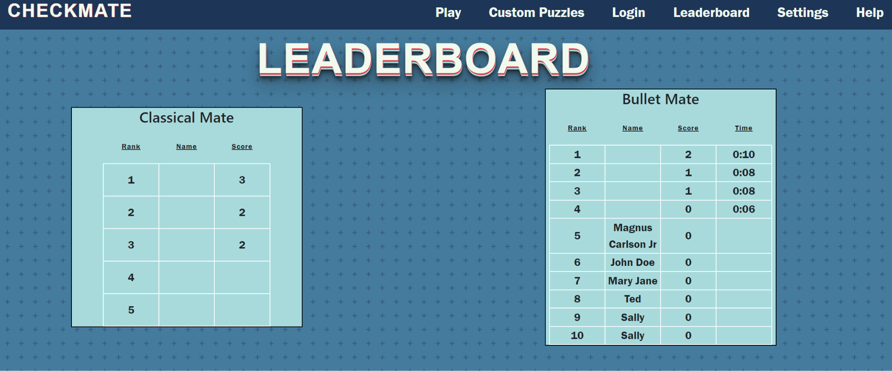
Leaderboard

Slide 15
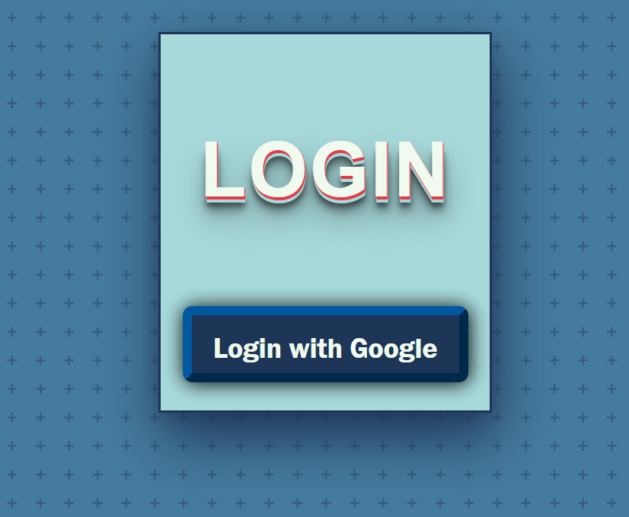
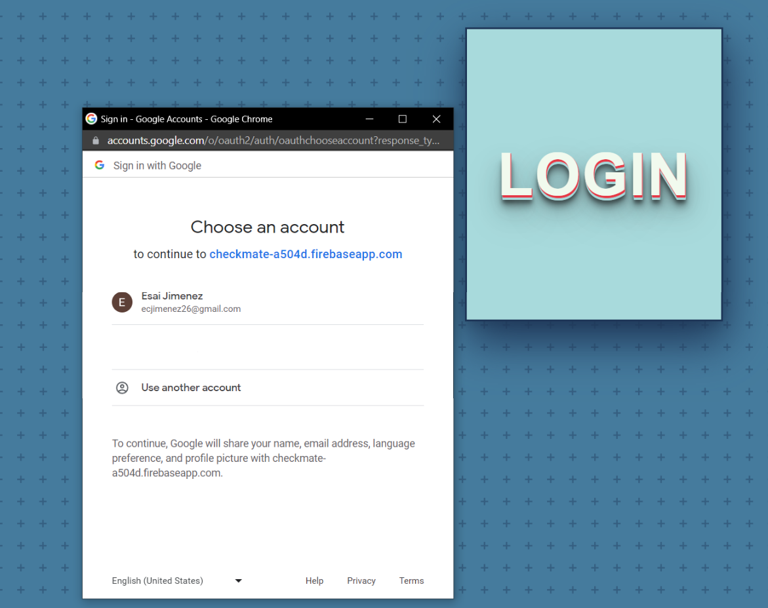
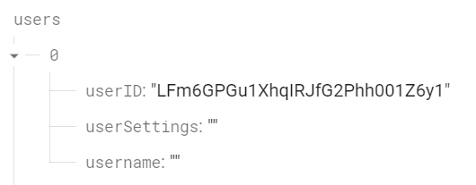
Login

Slide 16
Help/About Us and Settings Page Progress
The Help/About Us page is complete in its entirety
This section is essentially large amounts of tutorial text and photos
Styling is complete for this page
The Settings page is not capable of displaying scores yet
The Settings page is also not able to turn off the legal moves dots yet

Slide 17
Help/About Us and Settings Changes
The Help/About Us page has some text changes
Changes were minor and made to provide better clarification
Some items in the Settings page were changed
“Scores” became “Recent Scores” to clarify that the list is not exhaustive
The dot selection setting was changed to provide pictures for clarification

Slide 18
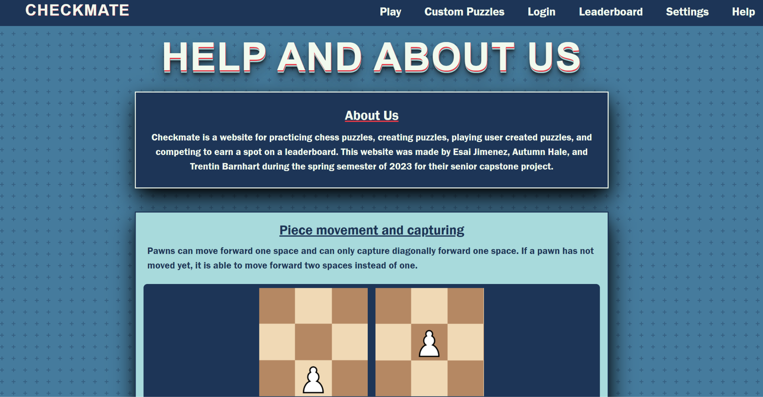
Help/About Us

Slide 19
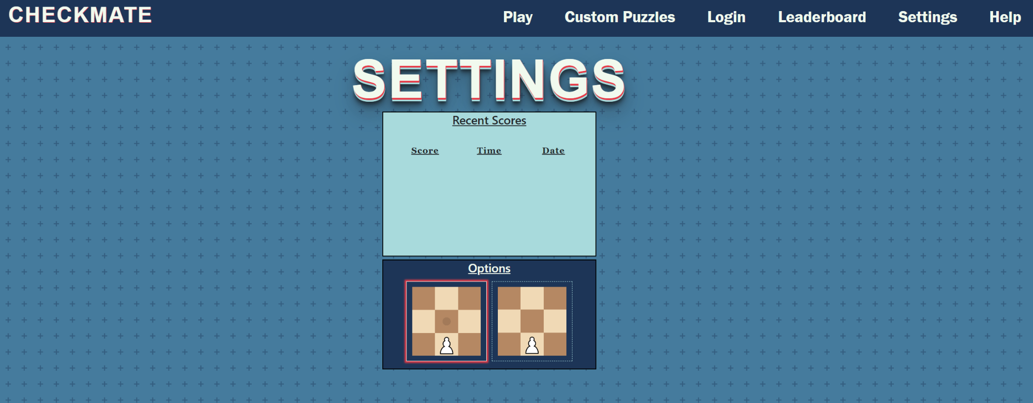
Settings

Slide 20
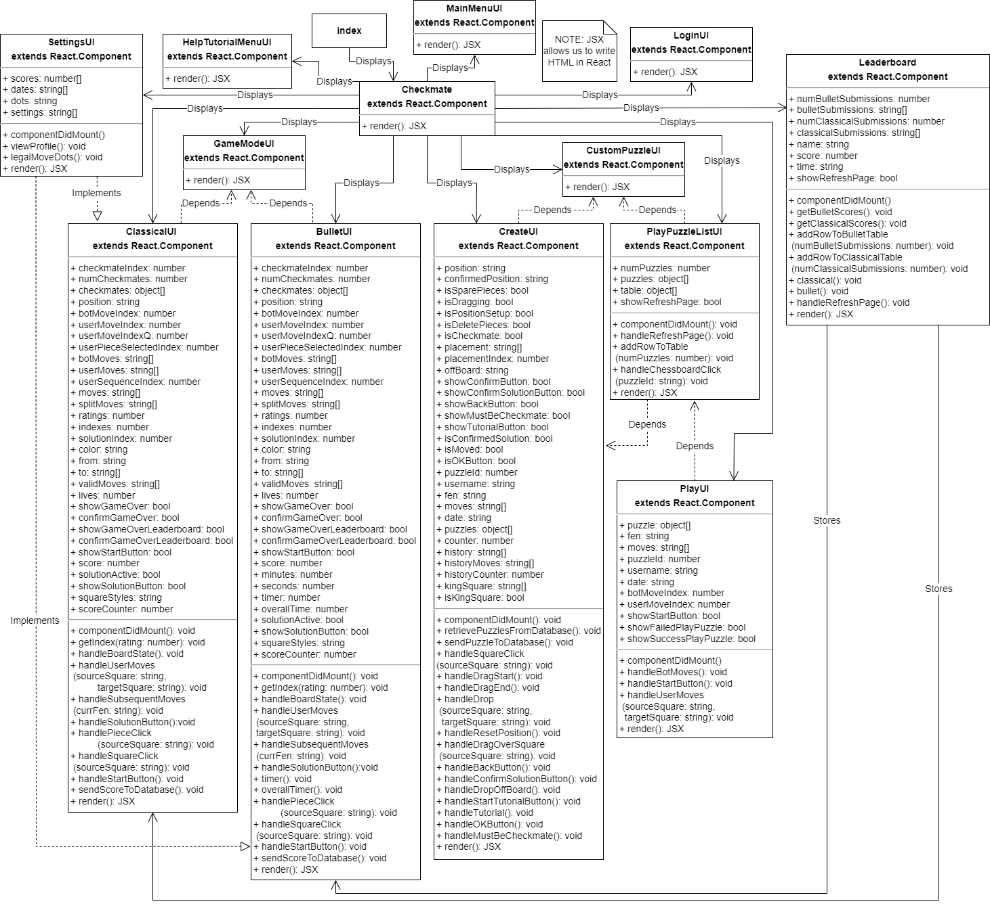
Updated Design Documentation
Deviations from Original:
ChessUI got split into two components, Classical and Bullet
The original diagram did not include the Play Puzzle List

Slide 21
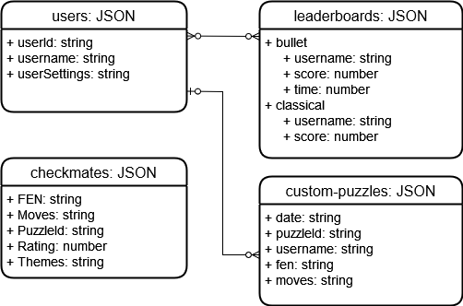
Updated ERD Diagram
Deviations from Original:
We are now storing “date” in custom-puzzles for the Play Puzzle List

Slide 22
Summary
Most of our features are implemented but there is still work to be done
The Firebase Authentication stands as the biggest hurdle and bottleneck
Most other features cannot be worked on until this is complete
Our minimum viable product is complete
Overall, things have progressed smoothly and hopefully this will continue throughout the final week

Slide 23
Questions?

